Slide 1

SCHOOL of COMPUTING
DEPARTMENT of COMPUTER SCIENCE & ENGINEERING
COURSE CATEGORY :PROGRAM CORE
COURSE NAME:DATA WAREHOUSING AND DATA MINING
COURSE CODE:1151CS114
FACULTY: Dr. CARMEL MARY BELINDA M J

Slide 2
Unit IV Association Rule Mining and Classification
Mining Association Rules in Large Databases
Mining Various Kinds of Association Rules
Correlation Analysis
Constraint Based Association Mining
Classification Basic Concepts
Decision Tree Induction
Bayesian Classification
Classification by Back propagation
Support Vector Machines
Associative Classification
Lazy Learners –
Other Classification Methods
Prediction

Slide 3
Mining Association Rules in Large Databases

Slide 4
What Is Association Rule Mining?
Association rule mining:
  Finding frequent patterns, associations, correlations, or causal structures among sets of items or objects in transactional databases, relational databases, and other information repositories
Motivation (market basket analysis):
  If customers are buying milk, how likely is that they also buy bread?
  Such rules help retailers to:
    plan the shelf space: by placing milk close to bread they may increase the sales
    provide advertisements/recommendation to customers that are likely to buy some products
    put items that are likely to be bought together on discount, in order to increase the sales

Slide 5
What Is Association Rule Mining?
Applications:
  Basket data analysis, cross-marketing, catalog design, loss-leader analysis, clustering, classification, etc.
Rule form: “Body → Ηead [support, confidence]”.
Examples.
  buys(x, “diapers”) → buys(x, “beers”) [0.5%, 60%]
  major(x, “CS”) ^ takes(x, “DB”) → grade(x, “A”) [1%, 75%]

Slide 6
Association Rules: Basic Concepts
Given: (1) database of transactions, (2) each transaction is a list of items (purchased by a customer in a visit)
Find: all rules that correlate the presence of one set of items with that of another set of items
  E.g., 98% of people who purchase tires and auto accessories also get automotive services done

Slide 7
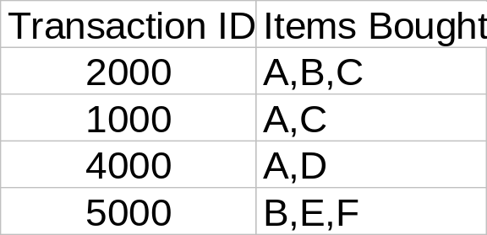
What are the components of rules?
In data mining, a set of items is referred to as an itemset
Let D be database of transactions
  e.g.:
Let I be the set of items that appear in the database, e.g., I={A,B,C,D,E,F}
A rule is defined by X ⇒ Y, where X⊂I, Y⊂I, and X∩Y=∅
  e.g.: {B,C} ⇒ {E} is a rule

Slide 8
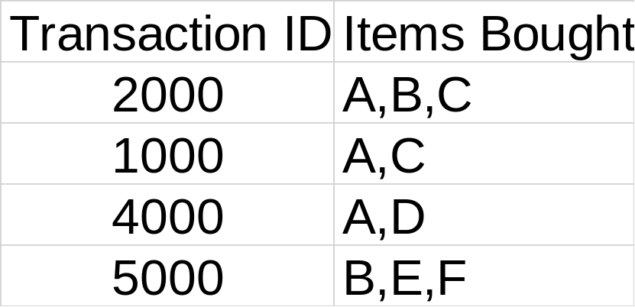
Rule Measures: Support and Confidence
Customer
buys both
Customer
buys diaper
Find all the rules X ⇒ Y with minimum confidence and support
  support, s, probability that a transaction contains {X ∪ Y}
  confidence, c, conditional probability that a transaction having X also contains Y
Customer
buys beer
Let minimum support 50%, and minimum confidence 50%, we have
  A ⇒ C (50%, 66.6%)
  C ⇒ A (50%, 100%)

Slide 9
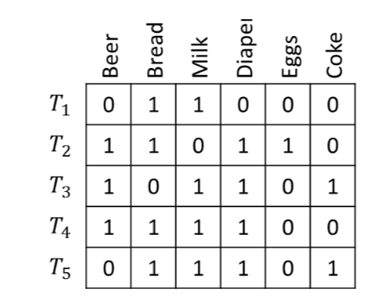
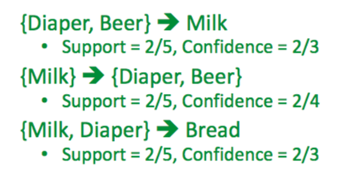
Dr.Carmel Mary Belinda M J /CSE

Slide 10
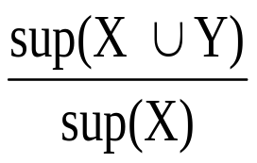
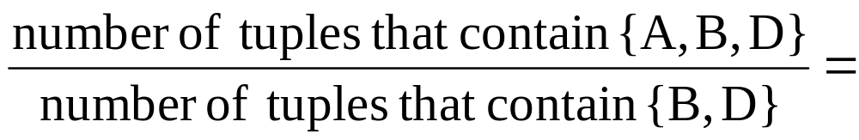
Example
TID date items_bought
100 10/10/99 {F,A,D,B}
200 15/10/99 {D,A,C,E,B}
300 19/10/99 {C,A,B,E}
400 20/10/99 {B,A,D}
Remember:
conf(X ⇒ Y) =
What is the support and confidence of the rule: {B,D} ⇒ {A}
Support:
  percentage of tuples that contain {A,B,D} =
75%
Confidence:
100%

Slide 11
Association Rule Mining
Boolean vs. quantitative associations (Based on the types of values handled)
  buys(x, “SQLServer”) ^ buys(x, “DMBook”) → buys(x, “DBMiner”) [0.2%, 60%]
  age(x, “30..39”) ^ income(x, “42..48K”) → buys(x, “PC”) [1%, 75%]
Single dimension
buys(x, “SQLServer”) ^ buys(x, “DMBook”) → buys(x, “DBMiner”) [0.2%, 60%]
multiple dimensional associations
age(x, “30..39”) ^ income(x, “42..48K”) → buys(x, “PC”) [1%, 75%]

Slide 12
Mining Association Rules
Two-step approach:
  Frequent Itemset Generation
    Generate all itemsets whose support ≥ minsup
  Rule Generation
    Generate high confidence rules from each frequent itemset, where each rule is a binary partitioning of a frequent itemset
Frequent itemset generation is still computationally expensive

Slide 13
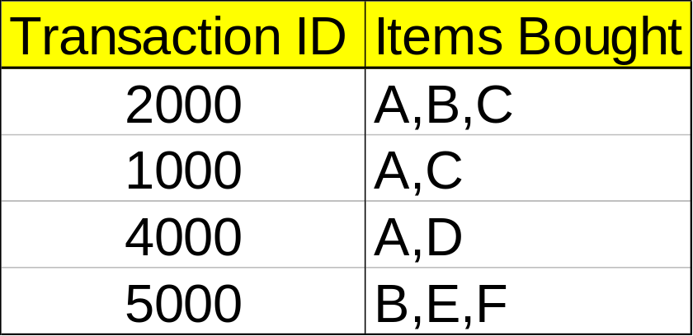
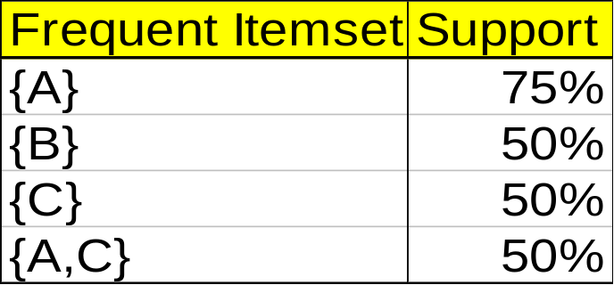
Mining Association Rules—An Example
Min. support 50%
Min. confidence 50%
For rule A ⇒ C:
  support = support({A ∪C}) = 50%
  confidence = support({A ∪C})/support({A}) = 66.6%
The Apriori principle:
  Any subset of a frequent itemset must be frequent!

Slide 14
Mining Frequent Itemsets: the Key Step
Find the frequent itemsets: the sets of items that have minimum support
  A subset of a frequent itemset must also be a frequent itemset
    i.e., if {AB} is a frequent itemset, both {A} and {B} should be a frequent itemset
  Iteratively find frequent itemsets with cardinality from 1 to m (m-itemset): Use frequent k-itemsets to explore (k+1)-itemsets.
Use the frequent itemsets to generate association rules.

Slide 15
The Apriori Algorithm
The name, Apriori, is based on the fact that the algorithm uses prior knowledge of frequent itemset properties
Apriori employs an iterative approach known as a level-wise search, where k-itemsets are used to explore (k+1)-itemsets
  The first pass determines the frequent 1-itemsets denoted L₁
  A subsequence pass k consists of two phases
    First, the frequent itemsets L_{k-1} are used to generate the candidate itemsets C_{k}
    Next, the database is scanned and the support of candidates in C_{k} is counted
    The frequent itemsets L_{k} are determined

Slide 16
Apriori Property
Apriori property: any subset of a large itemset must be large
  If {beer, diaper, nuts} is frequent, so is {beer, diaper}
  Every transaction having {beer, diaper, nuts} also contains {beer, diaper}
Anti-monotone: if a set cannot pass a test, all of its supersets will fail the same test as well

Slide 17
Apriori: A Candidate Generation-and-test Approach
Apriori pruning principle: If there is any itemset which is infrequent, its superset should not be generated/tested!
Method: join and prune steps
  Generate candidate (k+1)-itemsets C_{k+1} from frequent k-itemsets L_{k}
  If any k-subset of a candidate (k+1)-itemset is not in L_{k}, then the candidate cannot be frequent either and so can be removed from C_{k}
  Test the candidates against DB to obtain L_{k+1}

Slide 18
The Apriori Algorithm
Pseudo-code:
    C_{k}: Candidate itemset of size k
    L_{k} : frequent itemset of size k
    L₁ = {frequent items};
    for (k = 1; L_{k} !=∅; k++)
    C_{k+1} = candidates generated from L_{k};
    for each transaction t in database
    increment the count of all candidates in C_{k+1} that are contained in t
    end
    L_{k+1} = candidates in C_{k+1} with min_support
    end
    return ∪_{k} L_{k};

Slide 19
Important Details of Apriori
How to generate candidates?
  Step 1: self-joining L_{k}
  Step 2: pruning
How to count supports of candidates?
Example of candidate-generation
  L₃={abc, abd, acd, ace, bcd}
  Self-joining: L₃*L₃
    abcd from abc and abd
    acde from acd and ace
  Pruning:
    acde is removed because ade is not in L₃
  C₄={abcd}

Slide 20
How to Generate Candidates?
Suppose the items in L_{k-1} are listed in an order
Step 1: self-joining L_{k-1}
  insert into C_{k}
  select p.item₁, p.item₂, …, p.item_{k-1}, q.item_{k-1}
  from L_{k-1} p, L_{k-1} q
  where p.item₁=q.item₁, …, p.item_{k-2}=q.item_{k-2}, p.item_{k-1} < q.item_{k-1}
Step 2: pruning
  forall itemsets c in C_{k} do
    forall (k-1)-subsets s of c do
      if (s is not in L_{k-1}) then delete c from C_{k}

Slide 21
Example
There are nine transactions in this database, that is, |D| = 9. And mini-Sup=2
Transaction | List of items
T100 | I1,I2,I5
T200 | I2,I4
T300 | I2, I3
T400 | I1, I2, I4
T500 | I1, I3
T600 | I2, I3
T700 | I1, I3
T800 | I1, I2, I3, I5
T900 | I1, I2, I3

Slide 22
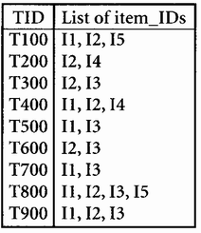
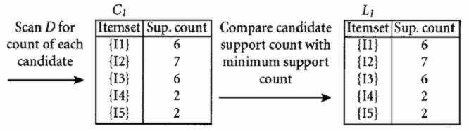
The Apriori Algorithm—Example
Let the minimum support be 2

Slide 23
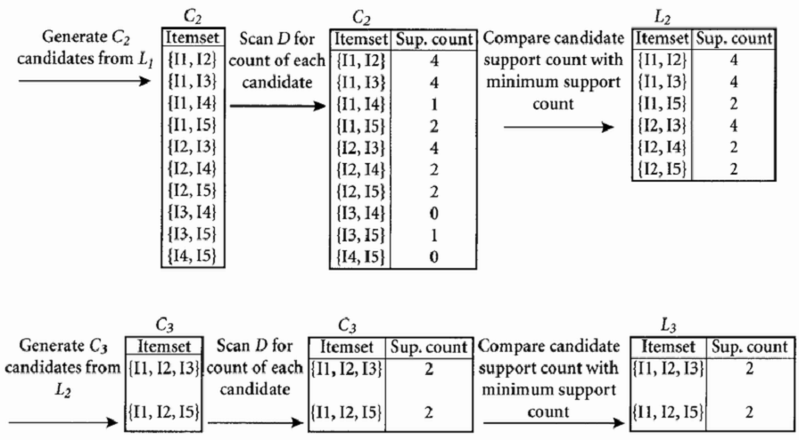

The Apriori Algorithm—Example

Slide 24
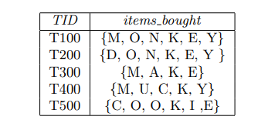
Example
A database has 5 transactions. Let min sup = 60% and min conf = 80%. Find all frequent itemset using Apriori

Slide 25
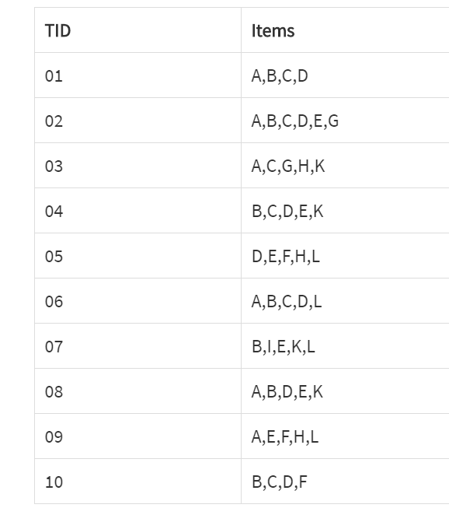
Example
Apply the Apriori algorithm with minimum support of 30% and minimum confidence of 70%,

Slide 26
Challenges of Frequent Pattern Mining
Challenges
  Multiple scans of transaction database
  Huge number of candidates
  Tedious workload of support counting for candidates
Improving Apriori: general ideas
  Reduce passes of transaction database scans
  Shrink number of candidates
  Facilitate support counting of candidates

Slide 27
How to Count Supports of Candidates?
Why counting supports of candidates a problem?
  The total number of candidates can be huge
  One transaction may contain many candidates
Method:
  Candidate itemsets are stored in a hash-tree
  Leaf node of hash-tree contains a list of itemsets and counts
  Interior node contains a hash table
  Subset function: finds all the candidates contained in a transaction

Slide 28
Methods to Improve Apriori’s Efficiency
Hash-based itemset counting: A k-itemset whose corresponding hashing bucket count is below the threshold cannot be frequent
Transaction reduction: A transaction that does not contain any frequent k-itemset is useless in subsequent scans
Partitioning: Any itemset that is potentially frequent in DB must be frequent in at least one of the partitions of DB
Sampling: mining on a subset of given data, lower support threshold + a method to determine the completeness
Dynamic itemset counting: add new candidate itemsets only when all of their subsets are estimated to be frequent

Slide 29
Factors Affecting Complexity
Choice of minimum support threshold
  lowering support threshold results in more frequent itemsets
  this may increase number of candidates and max length of frequent itemsets
Dimensionality (number of items) of the data set
  more space is needed to store support count of each item
  if number of frequent items also increases, both computation and I/O costs may also increase
Size of database
  since Apriori makes multiple passes, run time of algorithm may increase with number of transactions
Average transaction width
  transaction width increases with denser data sets
  This may increase max length of frequent itemsets and traversals of hash tree (number of subsets in a transaction increases with its width)

Slide 30
Rule Generation
Given a frequent itemset L, find all non-empty subsets f ⊂ L such that f → L – f satisfies the minimum confidence requirement
  If {A,B,C,D} is a frequent itemset, candidate rules:
    ABC →D, ABD →C, ACD →B, BCD →A,
    A →BCD, B →ACD, C →ABD, D →ABC
    AB →CD, AC → BD, AD → BC, BC →AD,
    BD →AC, CD →AB,

Slide 31
Rule Generation
How to efficiently generate rules from frequent itemsets?
  In general, confidence does not have an anti-monotone property
    c(ABC →D) can be larger or smaller than c(AB →D)
  But confidence of rules generated from the same itemset has an anti-monotone property
  e.g., L = {A,B,C,D}:
  c(ABC → D) ≥ c(AB → CD) ≥ c(A → BCD)
    Confidence is anti-monotone w.r.t. number of items on the RHS of the rule

Slide 32
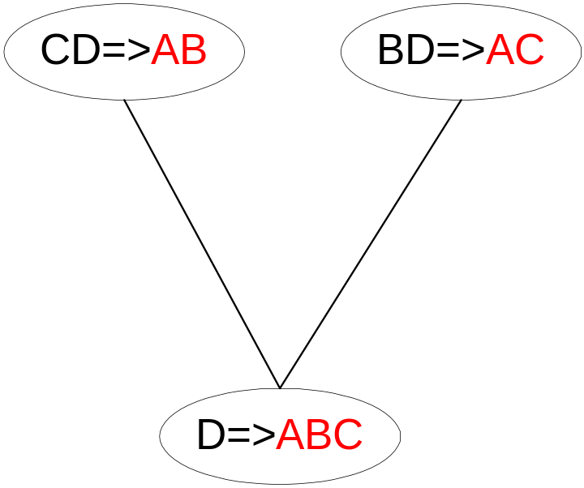
Rule Generation for Apriori Algorithm
Candidate rule is generated by merging two rules that share the same prefix
in the rule consequent
join(CD=>AB,BD=>AC)
would produce the candidate
rule D => ABC
Prune rule D=>ABC if its
subset AD=>BC does not have
high confidence

Slide 33
FP growth algorithm
This algorithm is an improvement to the Apriori method. A frequent pattern is generated without the need for candidate generation.
FP growth algorithm represents the database in the form of a tree called a frequent pattern tree or FP tree.
This tree structure will maintain the association between the itemsets.
The database is fragmented using one frequent item. This fragmented part is called “pattern fragment”. The itemsets of these fragmented patterns are analyzed. Thus with this method, the search for frequent itemsets is reduced comparatively.

Slide 34
FP Tree
Frequent Pattern Tree is a tree-like structure that is made with the initial itemsets of the database. The purpose of the FP tree is to mine the most frequent pattern. Each node of the FP tree represents an item of the itemset.
The root node represents null while the lower nodes represent the itemsets. The association of the nodes with the lower nodes that is the itemsets with the other itemsets are maintained while forming the tree.

Slide 35
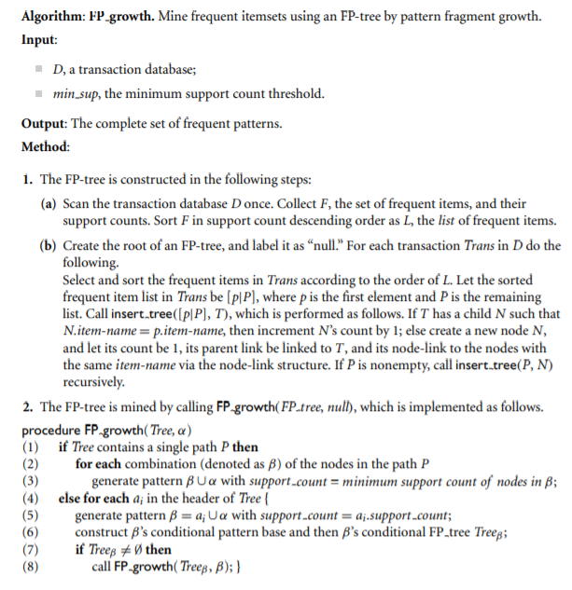
Frequent Pattern Algorithm Steps

Slide 36
EXAMPLE
Transaction | List of items
T100 | I1,I2,I5
T200 | I2,I4
T300 | I2, I3
T400 | I1, I2, I4
T500 | I1, I3
T600 | I2, I3
T700 | I1, I3
T800 | I1, I2, I3, I5
T900 | I1, I2, I3

Slide 37
Solution:Support threshold min_sup=2
Count of each item
Item | Count
I2 | 7
I1 | 6
I3 | 6
I4 | 2
I5 | 2

Slide 38
Sort the itemset in descending order
Item | Count
I2 | 7
I1 | 6
I3 | 6
I4 | 2
I5 | 2

Slide 39
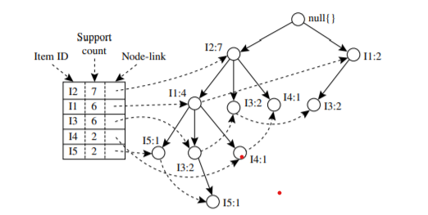
Build FP Tree
Transaction | List of items
T100 | I1,I2,I5
T200 | I2,I4
T300 | I2, I3
T400 | I1, I2, I4
T500 | I1, I3
T600 | I2, I3
T700 | I1, I3
T800 | I1, I2, I3, I5
T900 | I1, I2, I3

Slide 40
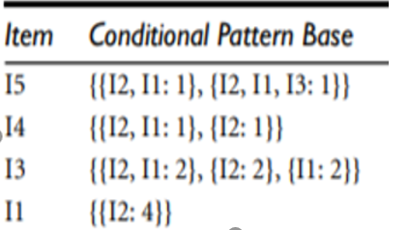
the Conditional Pattern Base is computed which is path labels of all the paths which lead to any node of the given item in the frequent-pattern tree.
Transaction | List of items
T100 | I1,I2,I5
T200 | I2,I4
T300 | I2, I3
T400 | I1, I2, I4
T500 | I1, I3
T600 | I2, I3
T700 | I1, I3
T800 | I1, I2, I3, I5
T900 | I1, I2, I3

Slide 41
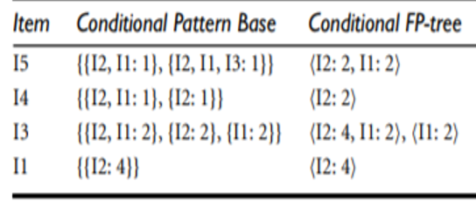
EXAMPLE
for each item the Conditional Frequent Pattern Tree is built. It is done by taking the set of elements which is common in all the paths in the Conditional Pattern Base of that item and calculating it’s support count by summing the support counts of all the paths in the Conditional Pattern Base.

Slide 42
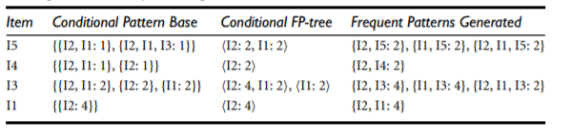
EXAMPLE
the Frequent Pattern rules are generated by pairing the items of the Conditional Frequent Pattern Tree set to the corresponding to the item as given in the below

Slide 43
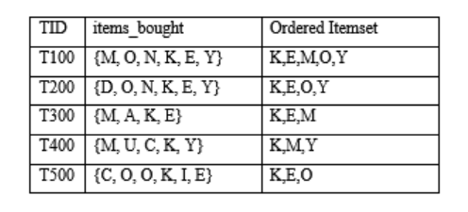
Example
A database has 5 transactions. Let min sup = 3.Find all frequent itemset using FP growth

Slide 44
Example
Item | Support Count Item | Support Count
A | 1 N |2
C | 2 U |1
D |1 Y |3
E |4
I |1
K |5
M |3
O |3

Slide 45
Example
Generate L, but with the largest support count to smallest
L = {{K: 5}, {E: 4}, {M: 3}, {O:3}, {Y: 3}}
Item |Support Count
K |5
E |4
M |3
O |3
Y |3

Slide 46
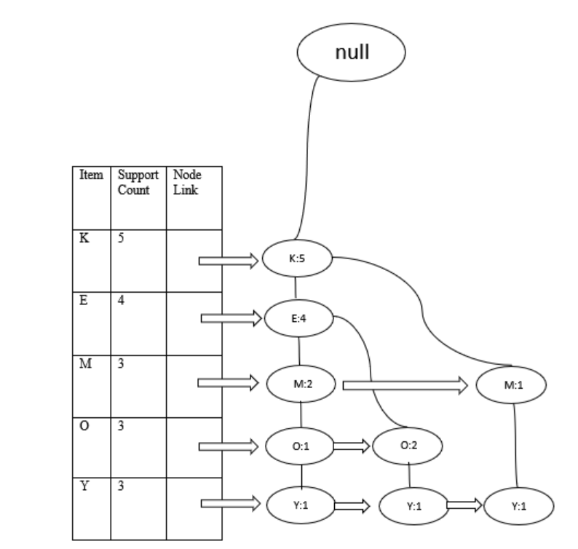
Example

Slide 47
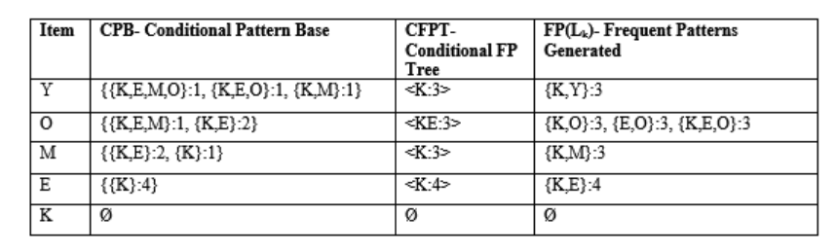
Example

Slide 48
Methods to Improve Apriori’s Efficiency
Hash-based itemset counting: A k-itemset whose corresponding hashing bucket count is below the threshold cannot be frequent
Transaction reduction: A transaction that does not contain any frequent k-itemset is useless in subsequent scans
Partitioning: Any itemset that is potentially frequent in DB must be frequent in at least one of the partitions of DB
Sampling: mining on a subset of given data, lower support threshold + a method to determine the completeness
Dynamic itemset counting: add new candidate itemsets only when all of their subsets are estimated to be frequent

Slide 49
Mining Frequent Itemsets Using the Vertical Data Format
Both the Apriori and FP-growth methods mine frequent patterns from a set of transactions in TID-itemset format (i.e., {TID : itemset}), where TID is a transaction ID and itemset is the set of items bought in transaction TID. This is known as the horizontal data format.
data can be presented in item-TID set format(i.e., {item : TID set}), where item is an item name, and TID set is the set of transaction identifiers containing the item. This is known as the vertical data format, which uses the Eclat (Equivalence Class Transformation) algorithm.

Slide 50
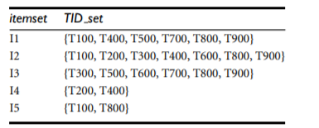
EXAMPLE
Consider the horizontal data format of the transaction database, D, of above example. This can be transformed into the vertical data format shown in above example by scanning the data set once. Mining can be performed on this data set by intersecting the TID sets of every pair of frequent single items. The minimum support count is 2

Slide 51
EXAMPLE
The Vertical Data Format of the Transaction Data Set D

Slide 52
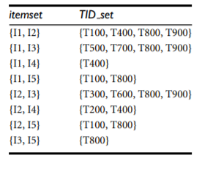
EXAMPLE
2-Itemsets in Vertical Data Format

Slide 53

EXAMPLE
3-Itemsets in Vertical Data Format

Slide 54
Multi-level Association: Uniform Support vs. Reduced Support
Uniform Support: the same minimum support for all levels
  + One minimum support threshold. No need to examine itemsets containing any item whose ancestors do not have minimum support.
  – Lower level items do not occur as frequently. If support threshold
    too high ⇒ miss low level associations
    too low ⇒ generate too many high level associations
Reduced Support: reduced minimum support at lower levels
  There are 4 search strategies:
    Level-by-level independent
    Level-cross filtering by k-itemset
    Level-cross filtering by single item
    Controlled level-cross filtering by single item (level passage threshold)

Slide 55
Uniform Support
Multi-level mining with uniform support
Level 1
min_sup = 5%
Milk
[support = 10%]
Level 2
min_sup = 5%
2% Milk
[support = 6%]
Skim Milk
[support = 4%]
Back

Slide 56
Reduced Support
Multi-level mining with reduced support
Level 1
min_sup = 5%
Milk
[support = 10%]
Level 2
min_sup = 3%
2% Milk
[support = 6%]
Skim Milk
[support = 4%]
Back

Slide 57
Multi-level Association: Redundancy Filtering
Some rules may be redundant due to “ancestor” relationships between items.
Example
  milk ⇒ wheat bread [support = 8%, confidence = 70%]
  2% milk ⇒ wheat bread [support = 2%, confidence = 72%]
We say the first rule is an ancestor of the second rule.
A rule is redundant if its support is close to the “expected” value, based on the rule’s ancestor.

Slide 58
Multi-Level Mining: Progressive Deepening
A top-down, progressive deepening approach:
  First mine high-level frequent items:
milk (15%), bread (10%)
  Then mine their lower-level “weaker” frequent itemsets:
2% milk (5%), wheat bread (4%)
Different min_support threshold across multi-levels lead to different algorithms:
  If adopting the same min_support across multi-levels
    then toss t if any of t’s ancestors is infrequent.
  If adopting reduced min_support at lower levels
    then examine only those descendents whose ancestor’s support is frequent/non-negligible.

Slide 59
Static Discretization of Quantitative Attributes
Discretized prior to mining using concept hierarchy.
Numeric values are replaced by ranges.
In relational database, finding all frequent k-predicate sets will require k or k+1 table scans.
Data cube is well suited for mining.
The cells of an n-dimensional
  cuboid correspond to the
  predicate sets.
Mining from data cubes
can be much faster.
()
(age)
(income)
(buys)
(age, income)
(age,buys)
(income,buys)
(age,income,buys)

Slide 60
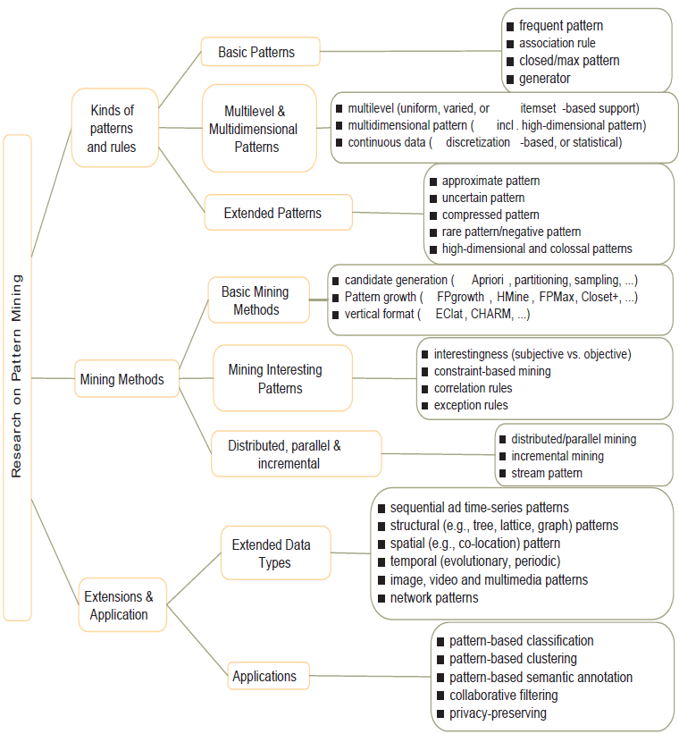
PATTERN MINING: A ROAD MAP

Slide 61
CONSTRAINT-BASED FREQUENT PATTERN MINING
The constraints can include the following:
Knowledge type constraints: These specify the type of knowledge to be mined, such as association, correlation, classification, or clustering.
Data constraints: These specify the set of task-relevant data.
Dimension/level constraints: These specify the desired dimensions (or attributes) of the data, the abstraction levels, or the level of the concept hierarchies to be used in mining.

Slide 62
Interestingness constraints: These specify thresholds on statistical measures of rule interestingness such as support, confidence, and correlation.
Rule constraints: These specify the form of, or conditions on, the rules to be mined. Such constraints may be expressed as metarules (rule templates), as the maximum or minimum number of predicates that can occur in the rule antecedent or consequent, or as relationships among attributes, attribute values, and/or aggregates.

Slide 63
Metarule-Guided Mining of Association Rules
Metarules allow users to specify the syntactic form of rules that they are interested in mining.
It is used to improve the efficiency of the mining process
A metarule can be used to specify information describing the form of rules you are interested in finding.
An example of such a metarule is
P1(X, Y) ∧ P2(X, W) ⇒ buys(X, “office software”),
where P1 and P2 are predicate variables that are instantiated to attributes from the given database during the mining process,
X is a variable representing a customer, and
Y and W take on values of the attributes assigned to P1 and P2, respectively.

Slide 64
The above Rule matches or complies with Metarule given below:
age(X, “30..39”) ∧ income(X, “41K..60K”)⇒buys(X, “office software”).
A metarule is a rule template of the form
P1 ∧ P2 ∧ ··· ∧ Pl ⇒ Q1 ∧ Q2 ∧ ··· ∧ Qr
where Pi (i = 1,..., l) and Qj (j = 1,..., r) are either instantiated predicates or predicate variables.

Slide 65
Let the number of predicates in the metarule be p = l + r.
To find interdimensional association rules satisfying the template,
We need to find all frequent p-predicate sets, Lp.
We must also have the support or count of the l-predicate subsets of Lp to compute the confidence of rules derived from Lp.

Slide 66
Constraint-Based Pattern Generation: Pruning Pattern Space
Pattern space pruning constraints
  Anti-monotonic: If constraint c is violated, its further mining can be terminated
  Monotonic: If c is satisfied, no need to check c again
  Succinct: c must be satisfied, so one can start with the data sets satisfying c
  Convertible: c is not monotonic nor anti-monotonic, but it can be converted into it if items in the transaction can be properly ordered
  Inconvertible: each element in c could be of any real value, is not convertible

Slide 67
Constraint-Based Pattern Generation: Pruning Data Space
Data space pruning constraint
  Data succinct: Data space can be pruned at the initial pattern mining process
  Data anti-monotonic: If a transaction t does not satisfy c, t can be pruned from its further mining

Slide 68
Property of Constraints: Anti-Monotone
Anti-monotonicity: If a set S violates the constraint, any superset of S violates the constraint.
Examples:
  sum(S.Price) ≤ v is anti-monotone
  sum(S.Price) ≥ v is not anti-monotone
  sum(S.Price) = v is partly anti-monotone
Application:
  Push “sum(S.price) ≤ 1000” deeply into iterative frequent set computation.

Slide 69
Anti-monotone and Monotone Constraints
A constraint C_{a} is anti-monotone iff. for any pattern S not satisfying C_{a}, none of the super-patterns of S can satisfy C_{a}
A constraint C_{m} is monotone iff. for any pattern S satisfying C_{m}, every super-pattern of S also satisfies it

Slide 70
Succinct Constraint
A subset of item I_{s} is a succinct set, if it can be expressed as σ_{p}(I) for some selection predicate p, where σ is a selection operator
SP⊆2^{I} is a succinct power set, if there is a fixed number of succinct set I₁, …, I_{k} ⊆I, s.t. SP can be expressed in terms of the strict power sets of I₁, …, I_{k} using union and minus
A constraint C_{s} is succinct provided SAT_{Cs}(I) is a succinct power set

Slide 71
Convertible Constraint
Suppose all items in patterns are listed in a total order R
A constraint C is convertible anti-monotone iff a pattern S satisfying the constraint implies that each suffix of S w.r.t. R also satisfies C
A constraint C is convertible monotone iff a pattern S satisfying the constraint implies that each pattern of which S is a suffix w.r.t. R also satisfies C

Slide 72
Relationships Among Categories of Constraints
Succinctness
Anti-monotonicity
Monotonicity
Convertible constraints
Inconvertible constraints

Slide 73
Property of Constraints: Anti-Monotone
Anti-monotonicity: If a set S violates the constraint, any superset of S violates the constraint.
Examples:
  sum(S.Price) ≤ v is anti-monotone
  sum(S.Price) ≥ v is not anti-monotone
  sum(S.Price) = v is partly anti-monotone
Application:
  Push “sum(S.price) ≤ 1000” deeply into iterative frequent set computation.

Slide 74
Characterization of
Anti-Monotonicity Constraints
S θ v, θ ∈ { =, ≤, ≥ }
v ∈ S
S ⊇ V
S ⊆ V
S = V
min(S) ≤ v
min(S) ≥ v
min(S) = v
max(S) ≤ v
max(S) ≥ v
max(S) = v
count(S) ≤ v
count(S) ≥ v
count(S) = v
sum(S) ≤ v
sum(S) ≥ v
sum(S) = v
avg(S) θ v, θ ∈ { =, ≤, ≥ }
(frequent constraint)
yes
no
no
yes
partly
no
yes
partly
yes
no
partly
yes
no
partly
yes
no
partly
convertible
(yes)

Slide 75
Example of Convertible Constraints: Avg(S) θ V
Let R be the value descending order over the set of items
  E.g. I={9, 8, 6, 4, 3, 1}
Avg(S) ≥ v is convertible monotone w.r.t. R
  If S is a suffix of S₁, avg(S₁) ≥ avg(S)
    {8, 4, 3} is a suffix of {9, 8, 4, 3}
    avg({9, 8, 4, 3})=6 ≥ avg({8, 4, 3})=5
  If S satisfies avg(S) ≥v, so does S₁
    {8, 4, 3} satisfies constraint avg(S) ≥ 4, so does {9, 8, 4, 3}

Slide 76
Property of Constraints: Succinctness
Succinctness:
  For any set S1 and S2 satisfying C, S1 ∪ S2 satisfies C
  Given A1 is the sets of size 1 satisfying C, then any set S satisfying C are based on A1 , i.e., it contains a subset belongs to A1 ,
Example :
  sum(S.Price ) ≥ v is not succinct
  min(S.Price ) ≤ v is succinct
Optimization:
  If C is succinct, then C is pre-counting prunable. The satisfaction of the constraint alone is not affected by the iterative support counting.

Slide 77
Characterization of Constraints by Succinctness
S θ v, θ ∈ { =, ≤, ≥ }
v ∈ S
S ⊇V
S ⊆ V
S = V
min(S) ≤ v
min(S) ≥ v
min(S) = v
max(S) ≤ v
max(S) ≥ v
max(S) = v
count(S) ≤ v
count(S) ≥ v
count(S) = v
sum(S) ≤ v
sum(S) ≥ v
sum(S) = v
avg(S) θ v, θ ∈ { =, ≤, ≥ }
(frequent constraint)
Yes
yes
yes
yes
yes
yes
yes
yes
yes
yes
yes
weakly
weakly
weakly
no
no
no
no
(no)

Slide 78
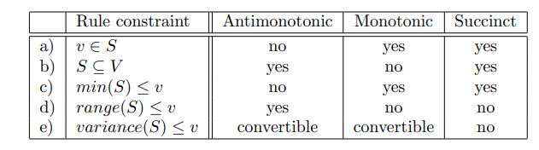
EXAMPLE
Prove that each entry in the following table correctly characterizes its corresponding rule constraint for frequent itemset mining.

Slide 79
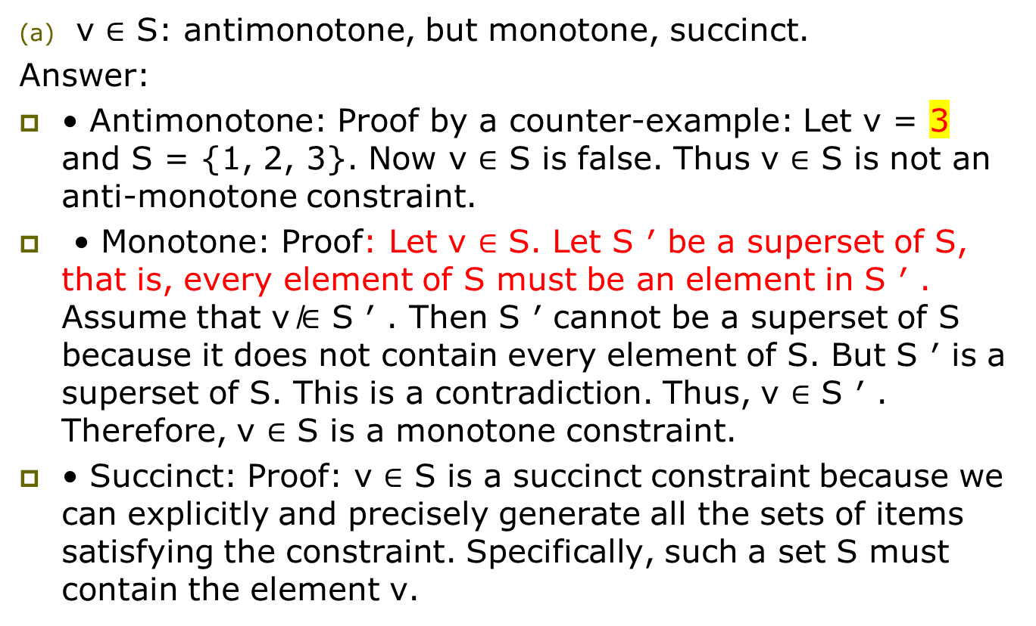

Slide 80
(b) S ⊆ V : antimonotone, not monotone, succinct.
Antimonotone: Proof: Let S ̸⊆ V . Then there must exist an element e ∈ S but e ̸∈ V . Let S ′ be a superset of S. Then that same element e is contained in every superset S ′ of S. Thus, S ′ ̸⊆ V . Therefore, S ⊆ V is an antimonotone constraint.
• Monotone: Proof by a counter-example: Let S = {1, 2, 3} and V = {1, 2, 3, 4, 5}. We have {1, 2, 3} ⊆{1, 2, 3, 4, 5}. However, by adding more elements to S, we have {1, 2, 3, 4, 5, 6, 7, 8} ̸⊆ {1, 2, 3, 4, 5}. Therefore, S ⊆ V is not a monotone constraint.
• Succinct: Proof: S ⊆ V is a succinct constraint because we can explicitly and precisely generate all the sets of items satisfying the constraint. Specifically, such a set S must not contain any items that V does not contain. Let Item be the set of all it

Slide 81
(c) min(S) ≤ v: not antimonotone, monotone, succinct.
Antimonotone: Proof by a counter-example: Let S = {6, 7, 8} and v = 5. min({6, 7, 8}) = 6 5. Adding more element, we may have {3, 4, 5, 6, 7, 8}⊃{6, 7, 8}. But min({3, 4, 5, 6, 7, 8}) = 3 ≤ 5. Therefore, min(S) ≤ v is not an antimonotone constraint.
• Monotone: Proof: Let min(S) ≤ v. Then there must exist an element e ∈ S such that e ≤ v. Let S ′ be a superset of S. Then that same element e is contained in every superset S ′ of S. Thus, min(S ′ ) ≤ e ≤ v. Therefore, min(S) ≤ v is a monotone constraint.
• Succinct: Proof: min(S) ≤ v is a succinct constraint because we can explicitly and precisely generate all the sets of items satisfying the constraint. Specifically, such a set S must contain at least one item whose value is no greater than v.

Slide 82
d).range(S) ≤ v: antimonotone, not monotone, not succinct
Antimonotone: Proof: Let range(S) > v where range(S) = max(S) − min(S). Then there must exist an element e ∈ S where e = max(S) and an element f ∈ S where f = min(S) such that e−f > v. Let S ′ be a superset of S. Elements e and f are contained in every superset S ′ of S. Clearly, max(S ′ ) ≥ e and min(S ′ ) ≤ f. Thus, range(S ′ ) = max(S ′ ) − min(S ′ ) ≥ e − f > v. Therefore, range(S) ≤ v is an antimonotone constraint.
Monotone: Proof by a counter-example: Let S = {4, 5, 6} and v = 5. range({4, 5, 6}) = 6 − 4 = 2 < 5. By adding some more elements, such as {1, 2, 3, 4, 5, 6, 7, 8} ⊃ {1, 2, 3}. However, range({1, 2, 3, 4, 5, 6, 7, 8}) = 8 − 1 = 7 5. Therefore, range(S) ≤ v is not a monotone constraint.
• Not Succinct: Proof by a counter-example: range(S) ≤ v is not a succinct constraint because we cannot explicitly and precisely generate all the sets of items satisfying the constraint. It depends on the maximum and the minimum of the set. For example: range(5, 6, 7) = 2 but range(4, 5, 6, 7, 8) ̸= 2. We cannot prune 4 or 8 from the original set of items because they may satisfy the constraint too, e.g., range(4, 5, 6) = 2 and range(6, 7, 8) = 2. Thus, we must use the “generate-and-test” approach at each iteration. Therefore, range(S) ≤ v is not a succinct constraint.

Slide 83
Classification: Basic Concepts and Decision Trees

Slide 84
Classification: Basic Concepts
Supervised learning (classification)
  Supervision: The training data (observations, measurements, etc.) are accompanied by labels indicating the class of the observations a New data is classified based on the training set
Unsupervised learning (clustering)
  The class labels of training data is unknown
Given a set of measurements, observations, etc. with the aim of establishing the existence of classes or clusters in the data

Slide 85
Classification—A Two-Step Process
Data classification is a two-step process, consisting of a learning step (where a classification model is constructed) and a classification step (where the model is used to predict class labels for given data)
Learning Step: describing a set of predetermined classes
Each tuple/sample is assumed to belong to a predefined class, as determined by the class label attribute
The set of tuples used for model construction: training set
The model is represented as classification rules, decision trees, or mathematical formulae

Slide 86
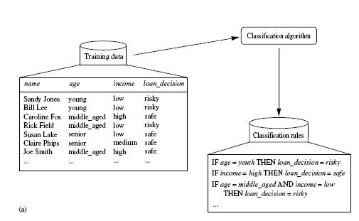
Learning Step

Slide 87
Classification step: for classifying future or unknown objects
Estimate accuracy of the model
The known label of test sample is compared with the classified result from the model
Accuracy rate is the percentage of test set samples that are correctly classified by the model
Test set is independent of training set, otherwise over-fitting will occur

Slide 88
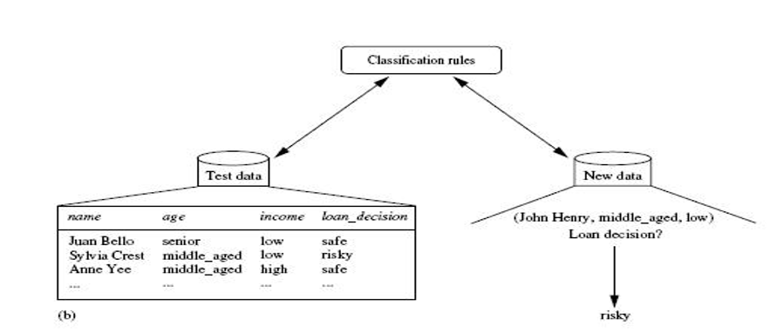
Classification step

Slide 89
Issues Regarding Classification and Prediction
Data cleaning: This refers to the preprocessing of data in order to remove or reduce noise (by applying smoothing techniques, for example) and the treatment of missing values (e.g., by replacing a missing value with the most commonly occurring value for that attribute, or with the most probable value based on statistics).
Relevance analysis: Many of the attributes in the data may be redundant. Correlation analysis can be used to identify whether any two given attributes are statistically related
Data transformation and reduction: The data may be transformed by normalization, particularly when neural networks or methods involving distance measurements are used in the learning step. Normalization involves scaling all values for a given attribute so that they fall within a small specified range, such as -1.0 to 1.0, or 0.0 to 1.0. In methods that use distance

Slide 90
Comparing Classification and Prediction Methods
Classification and prediction methods can be compared and evaluated according to the following criteria:
Accuracy − Accuracy of classifier refers to the ability of classifier. It predict the class label correctly and the accuracy of the predictor refers to how well a given predictor can guess the value of predicted attribute for a new data.
Speed − This refers to the computational cost in generating and using the classifier or predictor.
Robustness − It refers to the ability of classifier or predictor to make correct predictions from given noisy data.
Scalability − Scalability refers to the ability to construct the classifier or predictor efficiently; given large amount of data.
Interpretability − It refers to what extent the classifier or predictor understands.

Slide 91
Classification by Decision Tree Induction
Decision tree
A flow-chart-like tree structure
Internal node denotes (nonleaf node) denotes a test on an attribute
Branch represents an outcome of the test
Leaf nodes represent class labels or class distribution(Terminal node)
The topmost node in a tree is the root node.
Decision tree generation consists of two phases
Tree construction
Tree pruning

Slide 92
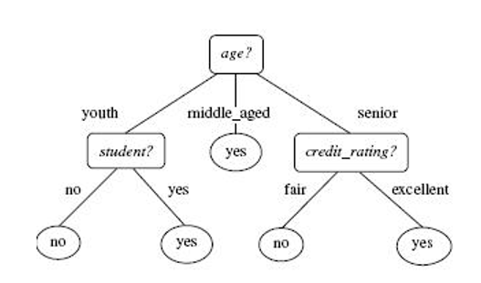
Decision Tree Induction
Tree construction
At start, all the training examples are at the root
Partition examples recursively based on selected attributes
Tree pruning
Identify and remove branches that reflect noise or outliers

Slide 93
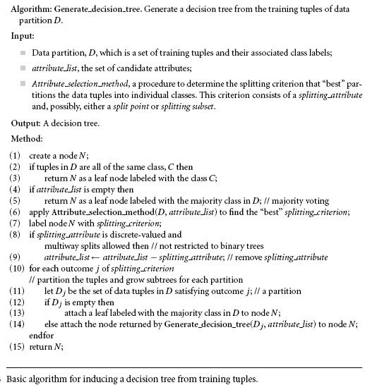
Decision Tree Induction

Slide 94
Decision Tree Induction
The algorithm consist of three parameters: D, attribute list, and Attribute selection method.
The parameter attribute list is a list of attributes describing the tuples.
Attribute selection method specifies a heuristic procedure for selecting the attribute that “best” discriminates the given tuples according to class
This procedure employs an attribute selection measure such as information gain or the Gini index. Whether the tree is strictly binary is generally driven by the attribute selection measure.
Some attribute selection measures, such as the Gini index, enforce the resulting tree to be binary.
information gain, do not, therein allowing multiway splits (i.e., two or more branches to be grown from a node).

Slide 95
Decision Tree Induction
The tree starts as a single node, N, representing the training tuples in D (step 1)
If the tuples in D are all of the same class, then node N becomes a leaf and is labeled with that class (steps 2 and 3).
Note that steps 4 and 5 are terminating conditions
Otherwise, the algorithm calls Attribute selection method to determine the splitting criterion. The splitting criterion tells us which attribute to test at node N by determining the ―best‖ way to separate or partition the tuples in D into individual classes(step 6).
The node N is labeled with the splitting criterion, which serves as a test at the node (step 7).
A branch is grown from node N for each of the outcomes of the splitting criterion (step 8 and 9).
The tuples in D are partitioned accordingly (steps 10 to 11).

Slide 96
Decision Tree Induction
There are three possible scenarios, as illustrated in Figure. Let A be the splitting attribute.
A has v distinct values, {a1, a2, : : : , av}, based on the training data
A is discrete-valued: In this case, the outcomes of the test at node N correspond directly to the known values of A. A branch is created for each known value, aj , of A and labeled with that value (Figure ). Partition Dj is the subset of class-labeled tuples in D having value aj of A. Because all the tuples in a given partition have the same value for A, A need not be considered in any future partitioning of the tuples. Therefore, it is removed from attribute list
A is continuous-valued: In this case, the test at node N has two possible outcomes, corresponding to the conditions A ≤ split point and A > split point, respectively, where split point is the split-point returned by Attribute selection method as part of the splitting criterion

Slide 97
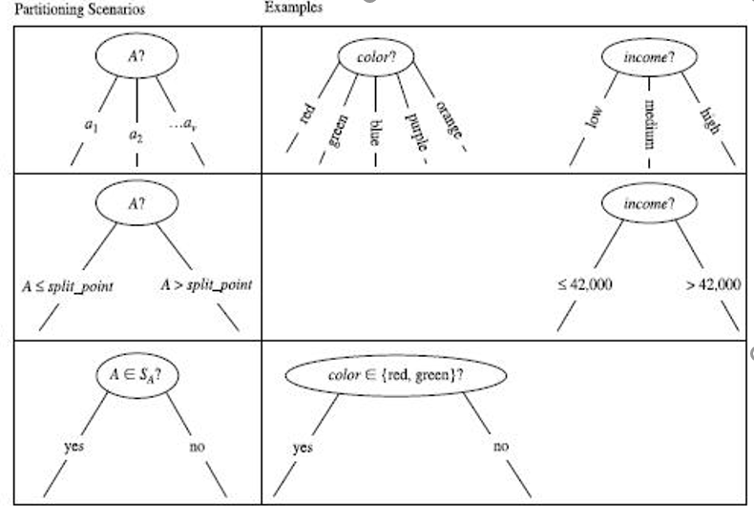
Decision Tree Induction
A is discrete-valued and a binary tree must be produced (as dictated by the attribute selection measure or algorithm being used): The test at node N is of the form “A ∈ SA?,” where SA is the splitting subset for A, returned by Attribute selection method as part of the splitting criterion.

Slide 98
Attribute Selection Measures
An attribute selection measure is a heuristic for selecting the splitting criterion that ―best ‖ separates a given data partition, D, of class-labeled training tuples into individual classes. If we were to split D into smaller partitions according to the outcomes of the splitting criterion,
If the splitting attribute is continuous-valued or if we are restricted to binary trees then, respectively, either a split point or a splitting subset must also be determined as part of the splitting criterion
This section describes three popular attribute selection measures—information gain, gain ratio, and gini index

Slide 99
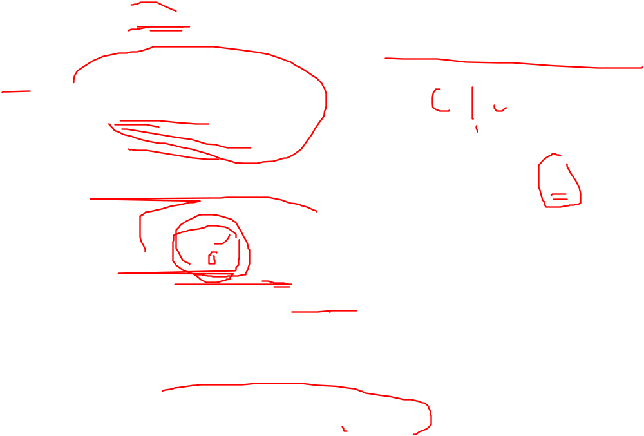
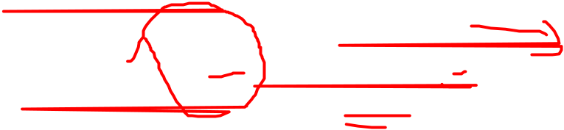



Information gain:ID3(Iterative Dichotomiser) uses information gain as its attribute selection measure.id3 is used to generate decision tree from data set
where pi is the nonzero probability that an arbitrary tuple in D belongs to class Ci
The term |Dj|/|D| acts as the weight of the jth partition.
Information gain is defined as the difference between the original information requirement (i.e., based on just the proportion of classes) and the new requirement (i.e., obtained after partitioning on A). That is,

Slide 100
In other words, Gain(A) tells us how much would be gained by branching on A. It is the expected reduction in the information requirement caused by knowing the value of A. The attribute A with the highest information gain, (Gain(A)), is chosen as the splitting attribute at node N.

Slide 101
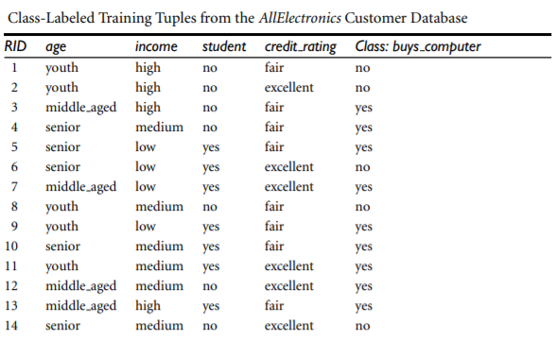
Example Induction of a decision tree using information gain.

Slide 102
Table presents a training set, D, of class-labeled tuples randomly selected from the AllElectronics customer database. The class label attribute, buys computer, has two distinct values (namely, {yes, no}); therefore, there are two distinct classes (that is, m = 2). Let class C1 correspond to yes and class C2 correspond to no. There are nine tuples of class yes and five tuples of class no. A (root) node N is created for the tuples in D. To find the splitting criterion for these tuples, we must compute the information gain of each attribute. We first use Equation (6.1) to compute the expected information needed to classify a tuple in D:

Slide 103


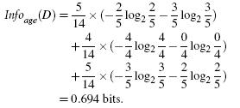
The expected information needed to classify a tuple in D if the tuples are partitioned according to age is

Slide 104
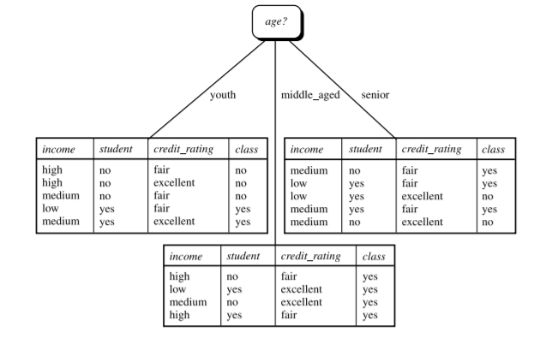

Similarly, we can compute Gain(income) = 0.029 bits, Gain(student) = 0.151 bits, and Gain(credit rating) = 0.048 bits.
Node N is labeled with age, and branches are grown for each of the attribute’s values. The tuples are then partitioned accordingly, as shown in Figure.

Slide 105



Gain Ratio
C4.5, a successor of ID3, uses an extension to information gain known as gain ratio.Information gain using a “split information” value defined analogously with Info(D) as
The gain ratio is defined as

Slide 106


Example:
Computation of gain ratio for the attribute income. A test on income splits the data of above Table into three partitions, namely low, medium, and high, containing four, six, and four tuples, respectively. To compute the gain ratio of income, we first use Eq. to obtain Split info
we have Gain(income) = 0.029. Therefore, Gain Ratio(income) = 0.029/1.557 = 0.019.

Slide 107



Gini Index
the Gini index measures the impurity of D, a data partition or set of training tuples, as
where pi is the probability that a tuple in D belongs to class Ci and is estimated by |C _{i,D}|/|D|. The sum is computed over m classes.
if a binary split on A partitions D into D1 and D2, the Gini index of D given that partitioning is

Slide 108


Example:
Induction of a decision tree using the Gini index. Let D be the training data shown earlier in above table , where there are nine tuples belonging to the class buys computer = yes and the remaining five tuples belong to the class buys computer = no. A (root) node N is created for the tuples in D. We first use Eq. for the Gini index to compute the impurity of D:

Slide 109
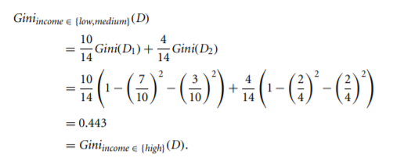

To find the splitting criterion for the tuples in D, we need to compute the Gini index for each attribute. Let’s start with the attribute income and consider each of the possible splitting subsets. Consider the subset {low, medium}. This would result in 10 tuples in partition D1 satisfying the condition “income ∈ {low, medium}.” The remaining four tuples of D would be assigned to partition D2. The Gini index value computed based on this partitioning is

Slide 110
Other Attribute Selection Measures
CHAID(Chi-square Automatic Interaction Detector), a decision tree algorithm that is popular in marketing, uses an attribute selection measure that is based on the statistical χ 2 test for independence.
C-SEP which performs better than information gain and the Gini index in certain cases
G-statistic an information theoretic measure that is a close approximation to χ 2 distribution.
Minimum Description Length (MDL) -based measures use encoding techniques to define the “best” decision tree as the one that requires the fewest number of bits to both (1) encode the tree and (2) encode the exceptions to the tree
Multivariate splits (i.e., where the partitioning of tuples is based on a combination of attributes, rather than on a single attribute)

Slide 111
Tree Pruning
Tree pruning is performed in order to remove anomalies in the training data due to noise or outliers. The pruned trees are smaller and less complex.
Tree Pruning Approaches
There are two approaches to prune a tree −
Pre-pruning − The tree is pruned by halting its construction early.
Post-pruning - This approach removes a sub-tree from a fully grown tree. A subtree at a given node is pruned by removing its branches and replacing it with a leaf

Slide 112
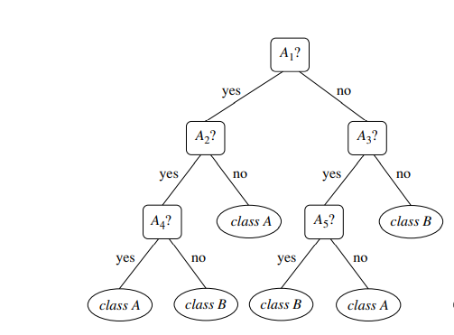
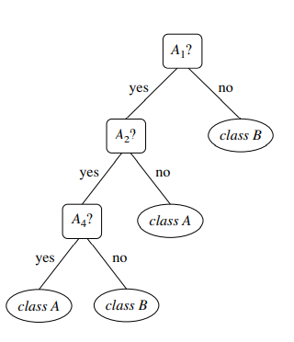
EXAMPLE
unpruned decision tree pruned decision tree

Slide 113
The leaf is labeled with the most frequent class among the subtree being replaced. For example, notice the subtree at node “A3?” in the unpruned tree
Suppose that the most common class within this subtree is “class B.” In the pruned version of the tree, the subtree in question is pruned by replacing it with the leaf “class B.

Slide 114
Cost Complexity-The cost complexity is measured by the following two parameters Number of leaves in the tree, and Error rate of the tree
For each internal node, N, it computes the cost complexity of the subtree at N, and the cost complexity of the subtree at N if it were to be pruned (i.e., replaced by a leaf node).
The two values are compared. If pruning the subtree at node N would result in a smaller cost complexity, then the subtree is pruned. Otherwise, it is kept.

Slide 115
C4.5 uses a method called pessimistic pruning, which is similar to the cost complexity method in that it also uses error rate estimates to make decisions regarding subtree pruning. Pessimistic pruning, however, does not require the use of a prune set.
Instead, it uses the training set to estimate error rates.
Decision trees can suffer from repetition and replication.
Repetition occurs when an attribute is repeatedly tested along a given branch of the tree(e.g., “age < 60?,” followed by “age < 45?,” and so on).
In replication, duplicate subtrees exist within the tree. These situations can impede the accuracy and comprehensibility of a decision tree.

Slide 116
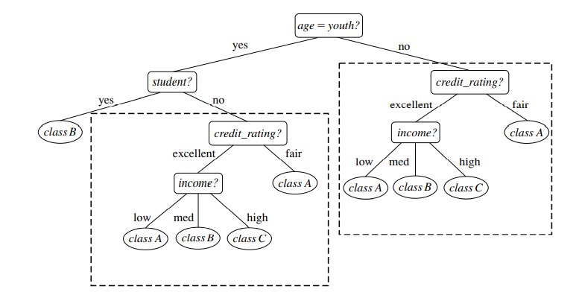
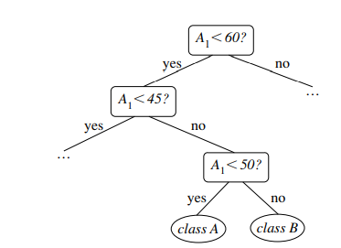
Repetition Replication

Slide 117
Bayes Classification Methods
Bayesian classifiers are statistical classifiers. They can predict class membership probabilities such as the probability that a given tuple belongs to a particular class.
Bayesian classifier known as the na¨ıve Bayesian classifier.
Bayesian classifiers have high accuracy and speed when applied to large databases.
Na¨ıve Bayesian classifiers assume that the effect of an attribute value on a given class is independent of the values of the other attributes. This assumption is called classconditional independence.

Slide 118
Bayes’ Theorem
Bayes’ theorem is named after Thomas Bayes.
Let X be a data tuple.
In Bayesian terms, X is considered “evidence.”
It is described by measurements made on a set of n attributes.
Let H be some hypothesis such as that the data tuple X belongs to a specified class C.
For classification problems, we want to determine P(H|X), the probability that the hypothesis H holds given the “evidence” or observed data tuple X.
In other words, we are looking for the probability that tuple X belongs to class C, given that we know the attribute description of X.

Slide 119
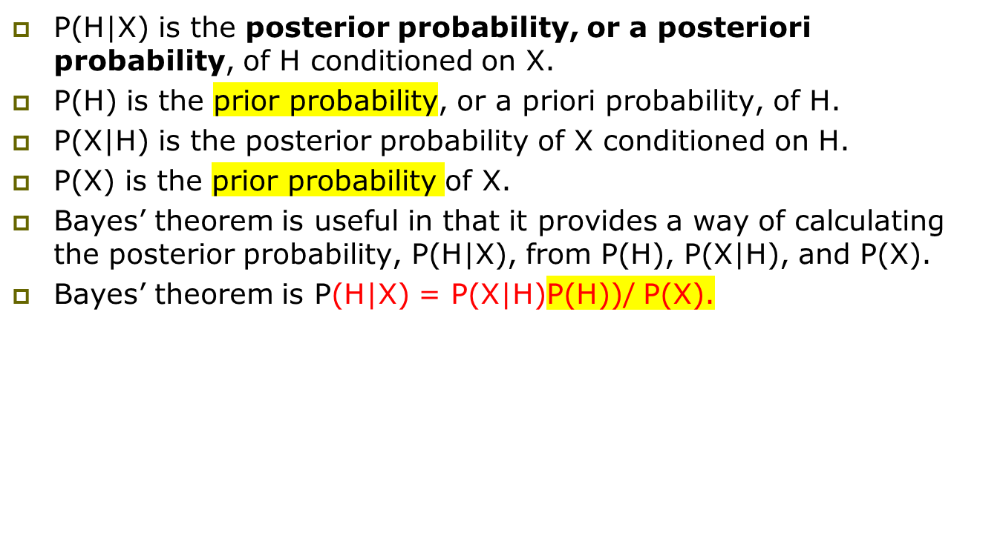

Slide 120

Na¨ıve Bayesian Classification
The na¨ıve Bayesian classifier, or simple Bayesian classifier, works as follows:
1.Let D be a training set of tuples and their associated class labels. As usual, each tuple is represented by an n-dimensional attribute vector, X = (x1, x2,..., xn), depicting n measurements made on the tuple from n attributes, respectively, A1, A2,..., An.
2. Suppose that there are m classes, C1, C2,..., Cm. Given a tuple, X, the classifier will predict that X belongs to the class having the highest posterior probability, conditioned on X. That is, the na¨ıve Bayesian classifier predicts that tuple X belongs to the class Ci if and only if

Slide 121

The class Ci for which P(Ci |X) is maximized is called the maximum posteriori hypothesis. By Bayes’ theorem
3. As P(X) is constant for all classes, only P(X|C_{i})P(C_{i}) needs to be maximized. If the class prior probabilities are not known, then it is commonly assumed that the classes are equally likely, that is, P(C1) = P(C2) = ··· = P(Cm), and we would therefore maximize P(X|C_{i}). Otherwise, we maximize P(X|C_{i})P(Ci). Note that the class prior probabilities may be estimated by P(Ci) = |C_{i,D}|/|D|, where |C_{i,D}| is the number of training tuples of class Ci in D.

Slide 122
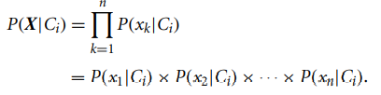
4. Given data sets with many attributes, it would be extremely computationally expensive to compute P(X|Ci). To reduce computation in evaluating P(X|Ci), the na¨ıve assumption of class-conditional independence is made. This presumes that the attributes’ values are conditionally independent of one another, given the class label of the tuple. Thus,

Slide 123


To compute P(X|Ci), we consider the following:
(a) If A_{k} is categorical, then P(x_{k} |Ci) is the number of tuples of class C_{i} in D having the value x_{k} for A_{k} , divided by |C_{i},D|, the number of tuples of class C_{i} in D.
(b) If A_{k} is continuous-valued, attribute is typically assumed to have a Gaussian distribution with a mean µ and standard deviation σ, defined by

Slide 124

5. To predict the class label of X, P(X|Ci)P(Ci) is evaluated for each class Ci . The classifier predicts that the class label of tuple X is the class Ci if and only if
the predicted class label is the class C_{i} for which P(X|C_{i)}P(C_{i}) is the maximum.

Slide 125
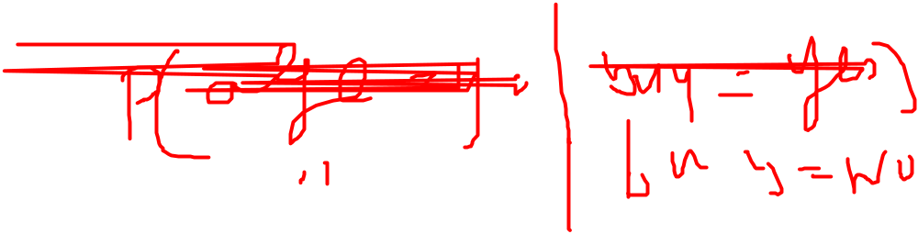
Example
Predicting a class label using na¨ıve Bayesian classification. We wish to predict the class label of a tuple using na¨ıve Bayesian classification, given the same training data as in previous Example for decision tree induction. The training data were shown earlier in Table 1.1. The data tuples are described by the attributes age, income, student, and credit rating. The class label attribute, buys computer, has two distinct values (namely, {yes, no}). Let C₁ correspond to the class buys computer = yes and C₂ correspond to buys computer = no. The tuple we wish to classify is
X = (age = youth, income = medium, student = yes, credit rating = fair)
We need to maximize P(X|Ci)P(Ci), for i = 1, 2. P(Ci), the prior probability of each class, can be computed based on the training tuples:

Slide 126
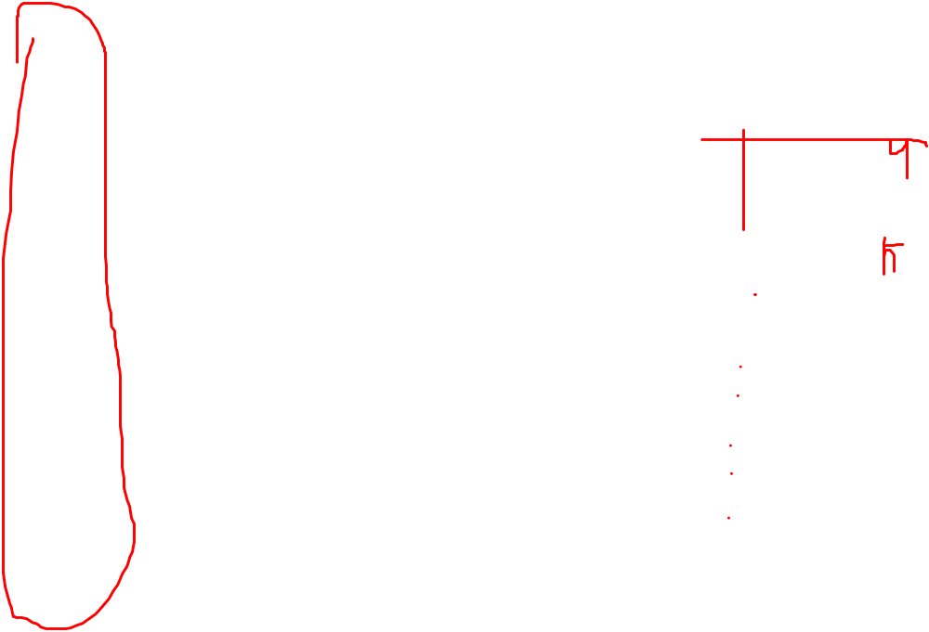

Slide 127
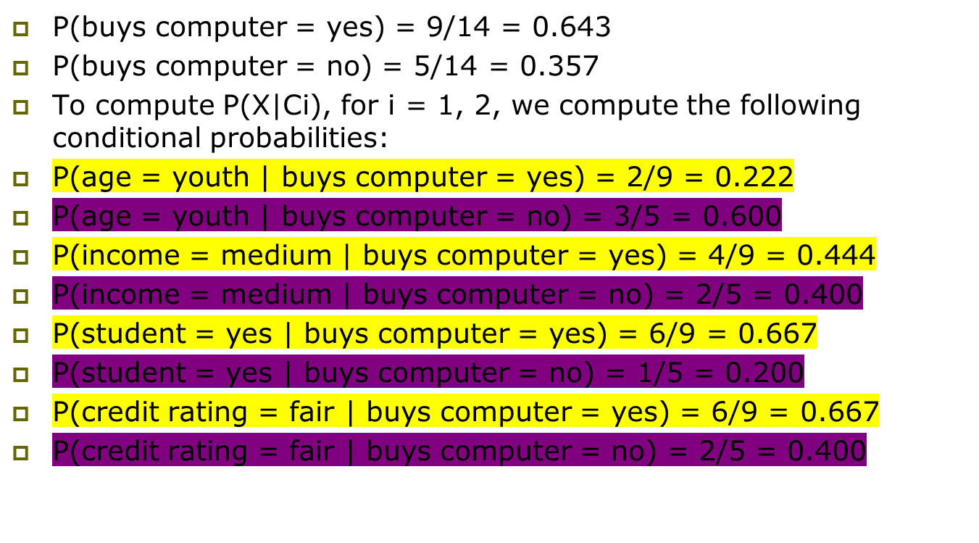

Slide 128
Using these probabilities, we obtain
P(X|buys computer = yes) = P(age = youth | buys computer = yes) × P(income = medium | buys computer = yes) × P(student = yes | buys computer = yes) × P(credit rating = fair | buys computer = yes)
= 0.222 × 0.444 × 0.667 × 0.667 = 0.044.
Similarly, P(X|buys computer = no) = 0.600 × 0.400 × 0.200 × 0.400 = 0.019.
To find the class, Ci , that maximizes P(X|Ci)P(Ci), we compute P(X|buys computer = yes)P(buys computer = yes)
= 0.044 × 0.643 = 0.028
P(X|buys computer = no)P(buys computer = no) = 0.019 × 0.357 = 0.007
Therefore, the na¨ıve Bayesian classifier predicts buys computer = yes for tuple X.

Slide 129
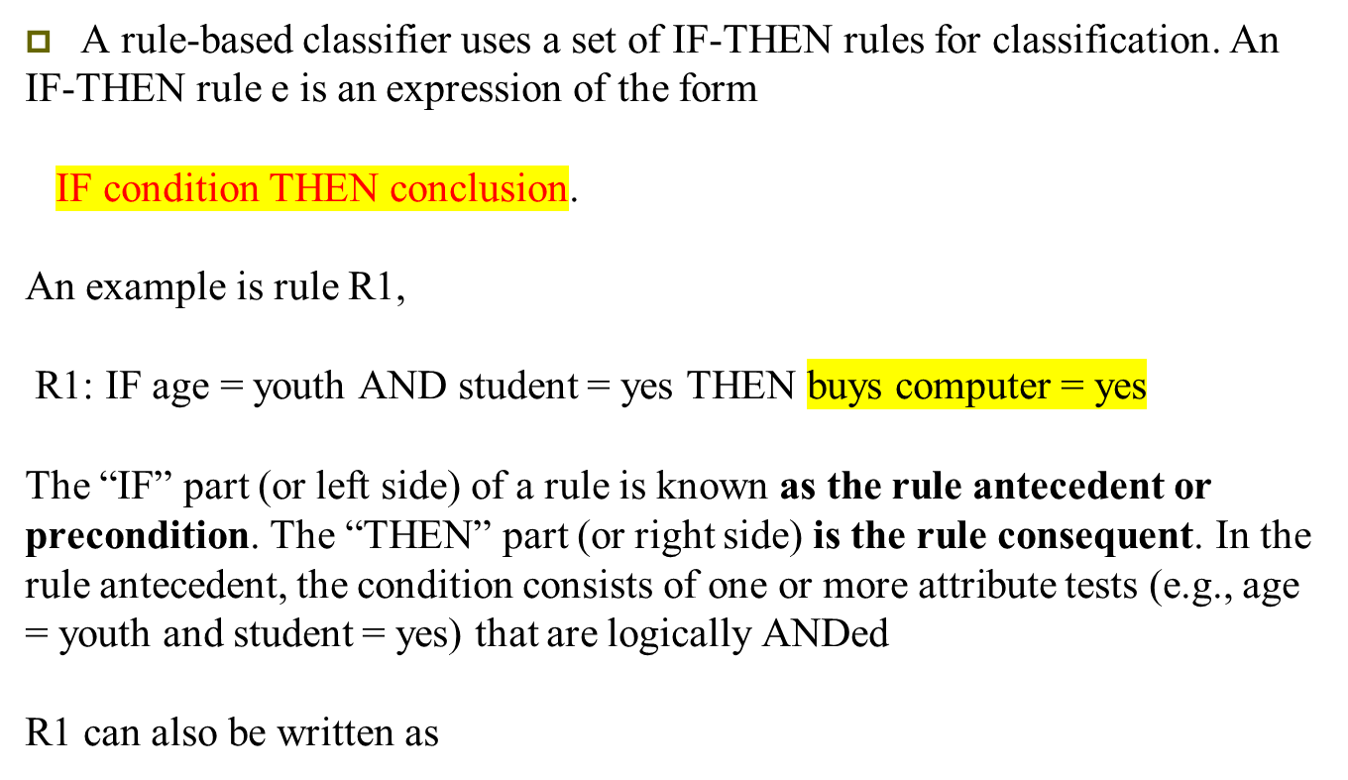
Rule-Based Classification

Slide 130

R1: (age = youth) ∧ (student = yes) ⇒ (buys computer = yes).
A rule R can be assessed by its coverage and accuracy.
Given a tuple, X, from a class labeled data set, D, let n_{covers} be the number of tuples covered by R; n_{correct} be the number of tuples correctly classified by R; and |D| be the number of tuples in D. We can define the coverage and accuracy of R as

Slide 131

Rule Extraction from a Decision Tree
To extract rules from a decision tree, one rule is created for each path from the root to a leaf node. Each splitting criterion along a given path is logically ANDed to form the rule antecedent (“IF” part). The leaf node holds the class prediction, forming the rule consequent (“THEN” part).
The decision tree of Figure can be converted to classification IF-THEN rules by tracing the path from the root node to each leaf node in the tree. The rules extracted from Figure are as follows:

Slide 132
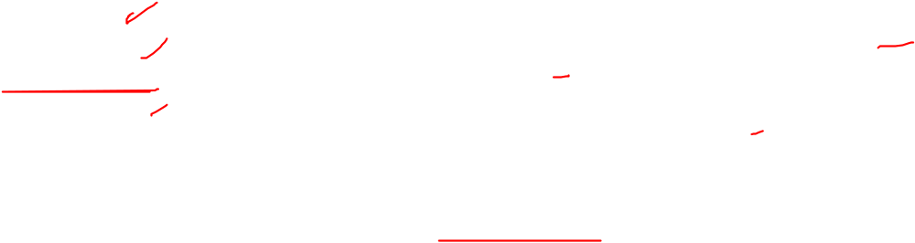
R1: IF age = youth AND student = no THEN buys computer = no R2: IF age = youth AND student = yes THEN buys computer = yes
R3: IF age = middle aged THEN buys computer = yes
R4: IF age = senior AND credit rating = excellent THEN buys computer = yes
R5: IF age = senior AND credit rating = fair THEN buys computer = no

Slide 133
Bayesian Belief Network
Bayesian Belief Networks specify joint conditional probability distributions. They are also known as Belief Networks, Bayesian Networks, or Probabilistic Networks.
A Belief Network allows class conditional independencies to be defined between subsets of variables.
It provides a graphical model of causal relationship on which learning can be performed.
We can use a trained Bayesian Network for classification.
There are two components that define a Bayesian Belief Network −
Directed acyclic graph
A set of conditional probability tables

Slide 134
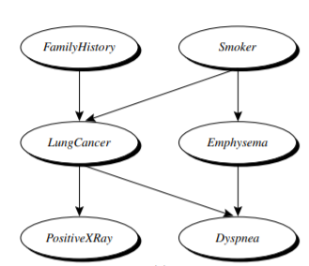
Directed Acyclic Graph
Each node in a directed acyclic graph represents a random variable.
These variable may be discrete or continuous valued.
These variables may correspond to the actual attribute given in the data.
Directed Acyclic Graph Representation
The following diagram shows a directed acyclic graph for six Boolean variables

Slide 135


Conditional Probability
Conditional Probability
The CPT for a variable Y specifies the conditional distribution P(Y|Parents(Y)), where Parents(Y) are the parents of Y.
Let X = (x1,..., xn) be a data tuple described by the variables or attributes Y1,..., Yn, respectively. Recall that each variable is conditionally independent of its nondescendants in the network graph, given its parents. This allows the network to provide a complete representation of the existing joint probability distribution with the following equation:
where P(x1,..., xn) is the probability of a particular combination of values of X, and the values for P(xi |Parents(Yi)) correspond to the entries in the CPT for Yi .

Slide 136


CLASSIFICATION BY BACKPROPAGATION
A MULTILAYER FEED-FORWARD NEURAL NETWORK
A multilayer feed-forward neural network consists of an input layer, one or more hidden layers, and an output layer

Slide 137
A MULTILAYER FEED-FORWARD NEURAL NETWORK
Each layer is made up of units.
The inputs to the network correspond to the attributes measured for each training tuple.
The inputs are fed simultaneously into the units making up the input layer.
These inputs pass through the input layer and are then weighted and fed simultaneously to a second layer of “neuronlike” units, known as a hidden layer.
The outputs of the hidden layer units can be input to another hidden layer, and so on.
The number of hidden layers is arbitrary, although in practice, usually only one is used.
The weighted outputs of the last hidden layer are input to units making up the output layer, which emits the network’s prediction for given tuples.
The units in the input layer are called input units.
The units in the hidden layers and output layer are sometimes referred to as neurodes, due to their symbolic biological basis, or as output units.
The multilayer neural network shown in Figure has two layers of output units. Therefore, we say that it is a two-layer neural network.

Slide 138


A network containing two hidden layers is called a three-layer neural network, and so on. It is a feed-forward network since none of the weights cycles back to an input unit or to a previous layer’s output unit. It is fully connected in that each unit provides input to each unit in the next forward layer.

Slide 139
BACKPROPAGATION
Backpropagation learns by iteratively processing a data set of training tuples, comparing the network’s prediction for each tuple with the actual known target value.
The target value may be the known class label of the training tuple (for classification problems) or a continuous value (for numeric prediction)

Slide 140

BACKPROPAGATION ALG

Slide 141
Initialize the weights: The weights in the network are initialized to small random numbers (e.g., ranging from −1.0 to 1.0, or −0.5 to 0.5). Each unit has a bias associated with it, as explained later. The biases are similarly initialized to small random numbers.
Each training tuple, X, is processed by the following steps.
Propagate the inputs forward: First, the training tuple is fed to the network’s input layer. The inputs pass through the input units, unchanged. That is, for an input unit, j, its output, Oj , is equal to its input value, Ij . Next, the net input and output of each unit in the hidden and output layers are computed.
To compute the net input to the unit, each input connected to the unit is multiplied by its corresponding weight, and this is summed. Given a unit, j in a hidden or output layer, the net input, Ij , to unit j is

Slide 142


wij is the weight of the connection from unit i in the previous layer to unit j; Oi is the output of unit i from the previous layer; and θj is the bias of the unit. The bias acts as a threshold in that it serves to vary the activity of the unit.
Each unit in the hidden and output layers takes its net input and then applies an activation function to it, as illustrated in Figure. The function symbolizes the activation of the neuron represented by the unit. The logistic, or sigmoid, function is used. Given the net input Ij to unit j, then Oj , the output of unit j, is computed as

Slide 143


Backpropagate the error: The error is propagated backward by updating the weights and biases to reflect the error of the network’s prediction. For a unit j in the output layer, the error Errj is computed by
where Oj is the actual output of unit j, and Tj is the known target value of the given training tuple. Note that Oj(1 − Oj) is the derivative of the logistic function.
To compute the error of a hidden layer unit j, the weighted sum of the errors of the units connected to unit j in the next layer are considered. The error of a hidden layer unit j is
where wjk is the weight of the connection from unit j to a unit k in the next higher layer, and Errk is the error of unit k.

Slide 144

The weights and biases are updated to reflect the propagated errors. Weights are updated by the following equations, where 1wij is the change in weight wij:

Slide 145


